Slide 1
Structure & Scale of the solar system
Day 32
Intro Video (4:34)
NO COMPUTERS TODAY
Take this opportunity to charge your device for the next class
Notes:
Power of 10 video 9 minutes, start as class starts and while taking attendance

Slide 2
Phenomena
What do you notice/ observe?
What do you wonder?
The moon as one pixel
Notes:
This is a video from NASA of Mercury passing in front of the SUN

Slide 3
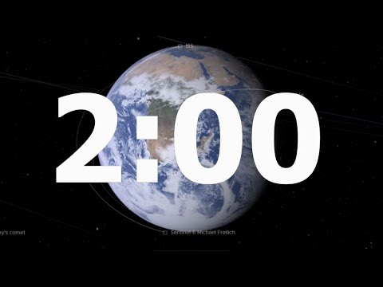
What objects are in our solar system?
How many can you list?
Turn and share with a neighbor

Slide 4
My Very Educated Mother Just Showed Us Nine Planets
Solar System 101 | National Geographic (4:13)

Slide 5
Let’s try an activity
Place the half sheet of paper I have given you lengthwise.
Place the sun along the very edge of the left side
Place a small circle at the very edge of the right side
Label it Pluto
Fill in the rest of the objects in the solar system where you think they would be

Slide 6
Scale of the Solar System on one piece of paper
SUN
Pluto and the Kuiper Belt
Draw the sun on the left side of your piece of paper and Pluto and the Kuiper Belt on the right side of the paper.
The sun is considered the center of our solar system, and Pluto and the Kuiper belt are considered the outside edge of the solar system.

Slide 7
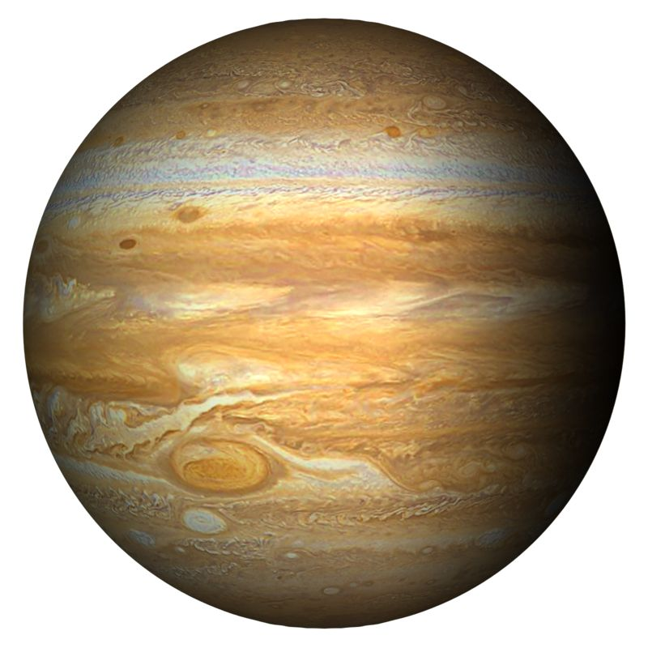
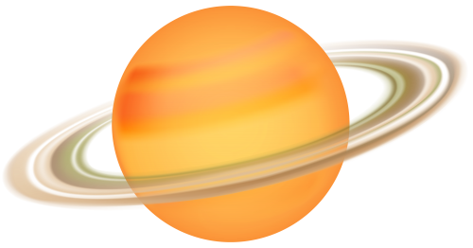
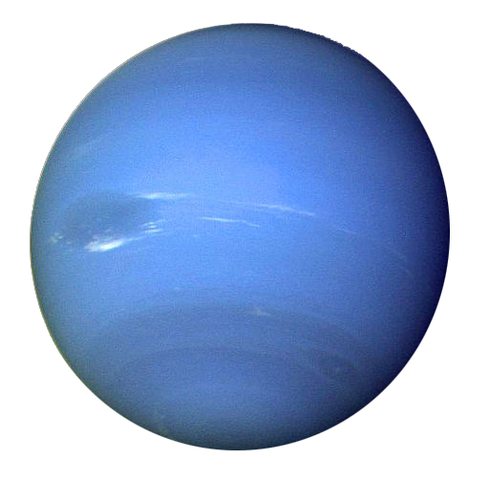
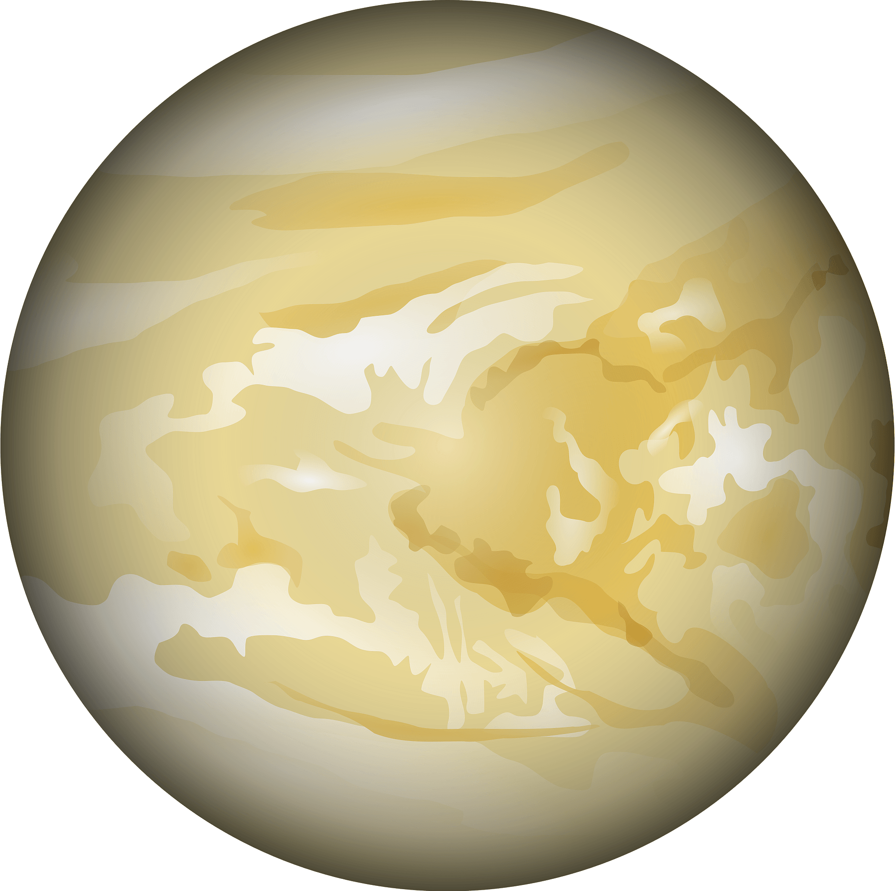
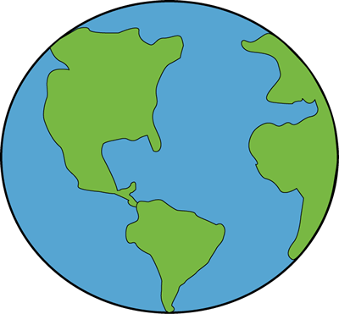
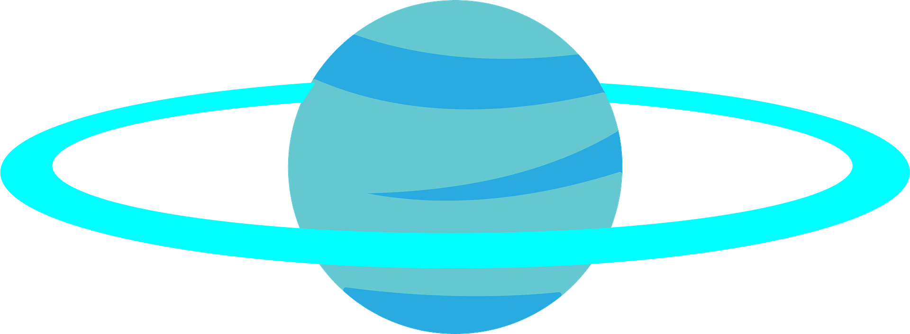
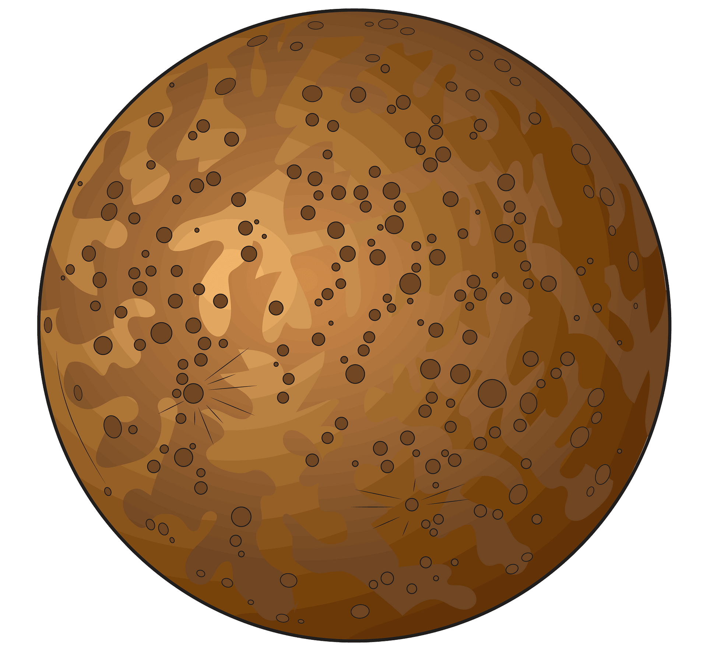

Scale of the Solar System on one piece of paper
SUN
Mercury
Mars
Pluto and the Kuiper Belt
Venus
Earth
Uranus
Neptune
Jupiter
Saturn
Draw everything that you know is in our solar system, based on how far apart things are (don’t worry about sizes). At a minimum you must include the 8 planets:
Mercury, Venus, Earth, Mars, Jupiter, Saturn, Uranus, Neptune

Slide 8
Scale of the Solar System on one piece of paper
SUN
Fold the paper in half

Slide 9
Scale of the Solar System on one piece of paper
SUN
Then, fold the paper in half a second time

Slide 10
Scale of the Solar System on one piece of paper
SUN
Pluto and the Kuiper Belt
¼
½
¾
Use a pen to label the fold lines as ¼,½, and ¾. These mark, the one quarter, halfway, and the three quarters distance points between the sun and Pluto.
(You don’t need to trace the fold lines with your pen)

Slide 11
Scale of the Solar System on one piece of paper
SUN
Pluto and the Kuiper Belt
Neptune
¼
½
¾
Use your pen to Draw a circle representing Neptune on the ¾ line.

Slide 12
Scale of the Solar System on one piece of paper
SUN
Pluto and the Kuiper Belt
Uranus
Neptune
¼
½
¾
Use your pen to Draw a circle representing Uranus on the ½ line.

Slide 13
Scale of the Solar System on one piece of paper
SUN
Pluto and the Kuiper Belt
Saturn
Uranus
Neptune
¼
½
¾
Use your pen to Draw a circle representing Saturn on the ¼ line.

Slide 14
Scale of the Solar System on one piece of paper
SUN
Pluto and the Kuiper Belt
Jupiter
Saturn
Uranus
Neptune
⅛
¼
½
¾
Fold the “SUN” edge of your paper to the ¼ mark. This new fold marks the ⅛^{th} point. Place Jupiter on the ⅛^{th} mark

Slide 15
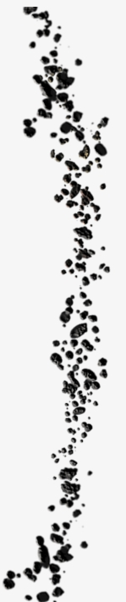
Scale of the Solar System on one piece of paper
SUN
Asteroid Belt
Pluto and the Kuiper Belt
Jupiter
Saturn
Uranus
Neptune
⅛
¼
½
¾
1/16
Fold the “SUN” edge of your paper to the ⅛ mark. This new fold marks the 1/16th point. Place the Asteroid Belt on the 1/16th mark

Slide 16
Scale of the Solar System on one piece of paper
SUN
Asteroid Belt
Mars
Pluto and the Kuiper Belt
Jupiter
Saturn
Uranus
Neptune
⅛
¼
½
¾
1/32
1/16
Fold the “SUN” edge of your paper to the 1/16 mark. This new fold marks the 1/32nd point. Place Mars on the 1/32nd mark

Slide 17
Scale of the Solar System on one piece of paper
SUN
Asteroid Belt
Mars
Pluto and the Kuiper Belt
Jupiter
Saturn
Uranus
Neptune
⅛
¼
½
¾
1/32
1/16
The first three planets fit in this small space between the sun and Mars… which you probably ran out of room to draw.

Slide 18
How big is the Solar System? (1:44)
SOLAR SYSTEM - 3D Comparison by MBS (1:50)

Slide 19
Our Sun is the most massive object in our solar system
This causes a gravitational pull towards the SUN
As objects fall towards the SUN and travel in their revolution around the SUN their orbit is created

Slide 20
Characteristics of the sun- fun facts
The Sun is in the center of our solar system
Compared to other stars, the Sun is a(n) average size sta
The Sun contains about 99% of the solar system’s mass; you can fit more than 1 million Earths inside the Sun
The Sun’s gravity holds our solar system together
Notes:
Do after we do Page 3 of the PBS lesson as a class?

Slide 21
Orbits: why doesn’t the moon fall down?
The planets travel in nearly circular (ellipse) orbits around the Sun at different distances and speeds.
The force of gravity between a planet and the Sun pulls the planet toward the Sun
Why don’t planets crash into the Sun from the pull of gravity?
The speed at which they move, the distance they are from the Sun, and they are trying to move perpendicular to the Sun’s gravity
Notes:
Do after we do Page 4 of the PBS lesson as a class?

Slide 22
All planet sizes
Inner planets: Mercury, Venus, Earth, Mars
Smaller planets formed out of rocks and metals
They are closer to the Sun, temperatures are hot
Outer planets: Jupiter, Saturn, Uranus, Neptune
Larger planets formed from icy materials and gases
Farther away from the Sun, temperatures are cool
What similarities and differences to you notice among the planets? Write at least one of each.
Notes:
Do after we do Page 5 of the PBS lesson as a class?

Slide 23
Scale models & measuring distance
_____________________ (AU) = the average distance between the Earth and the Sun
Example: Mars is about 228,000,000 kilometers (142 million miles) away from the Sun, or _____ AU from the Sun (or about 1.5 times the distance between the Earth and the Sun)
Astronomical units
1.5
Notes:
Do after we do Pages 7 and 8 of the PBS lesson as a class?

Slide 24
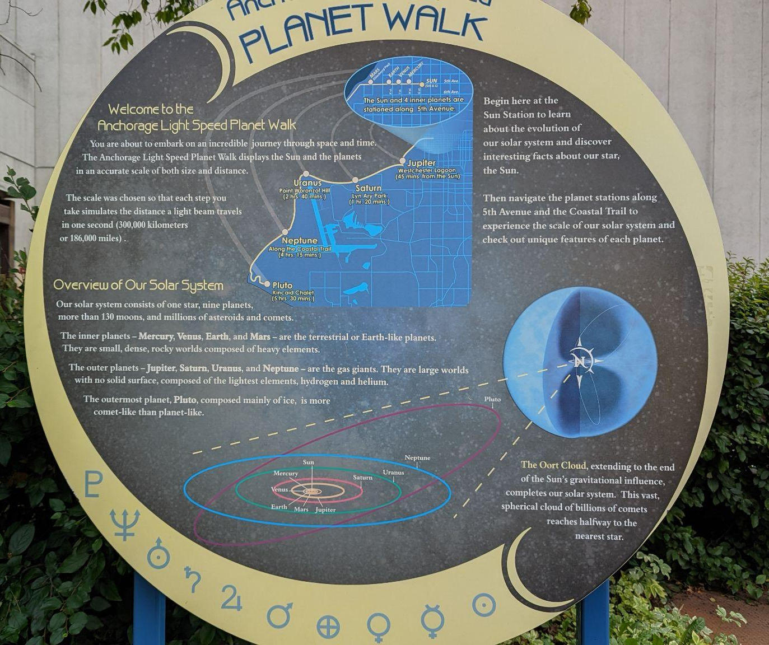
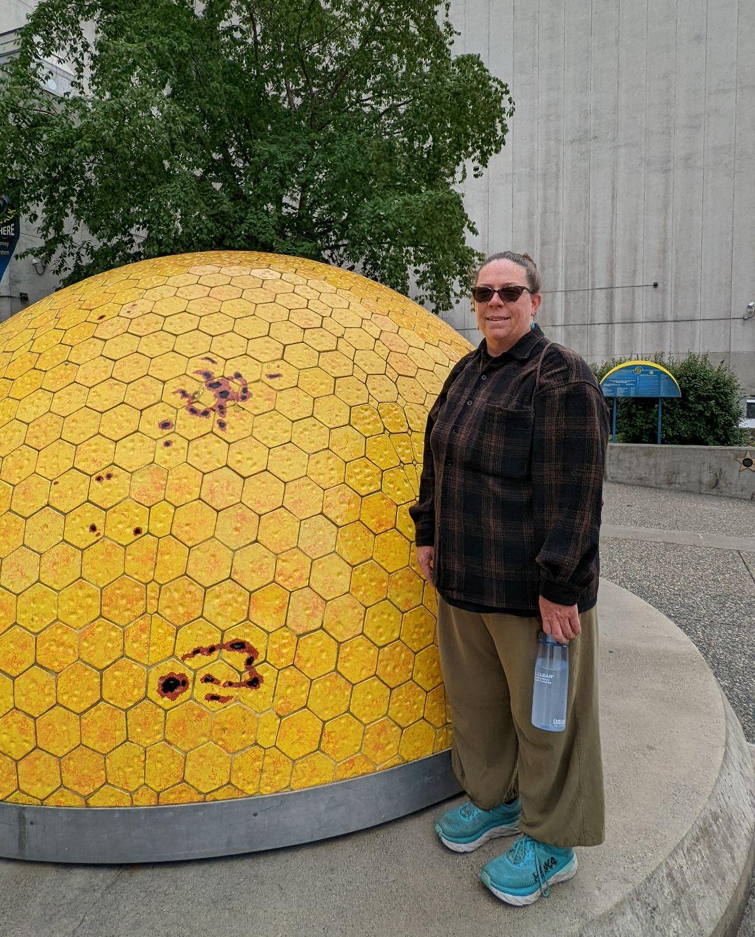
This is Ms. Knight. She visited Anchorage Alaska in July. She is standing at the SUN in the photo above, which is the start of the Anchorage planet walk.
Notes:
This was designed by Eli Menaker, a 2004 graduate of Service High school in Anchorage.
https://anchorageplanetwalk.org/

Slide 25
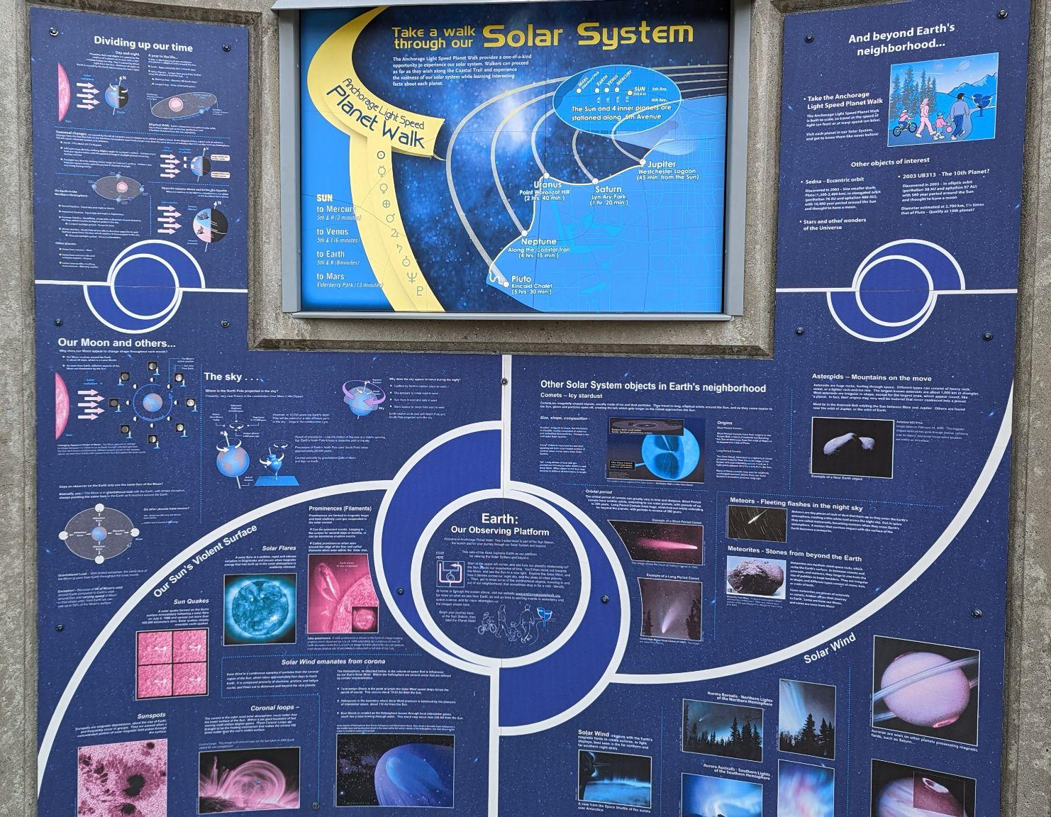
If you start at the sun and walk at a comfortable pace, every step would take you one light second. If you travel by bike or car it would represent warp speed.

Slide 26
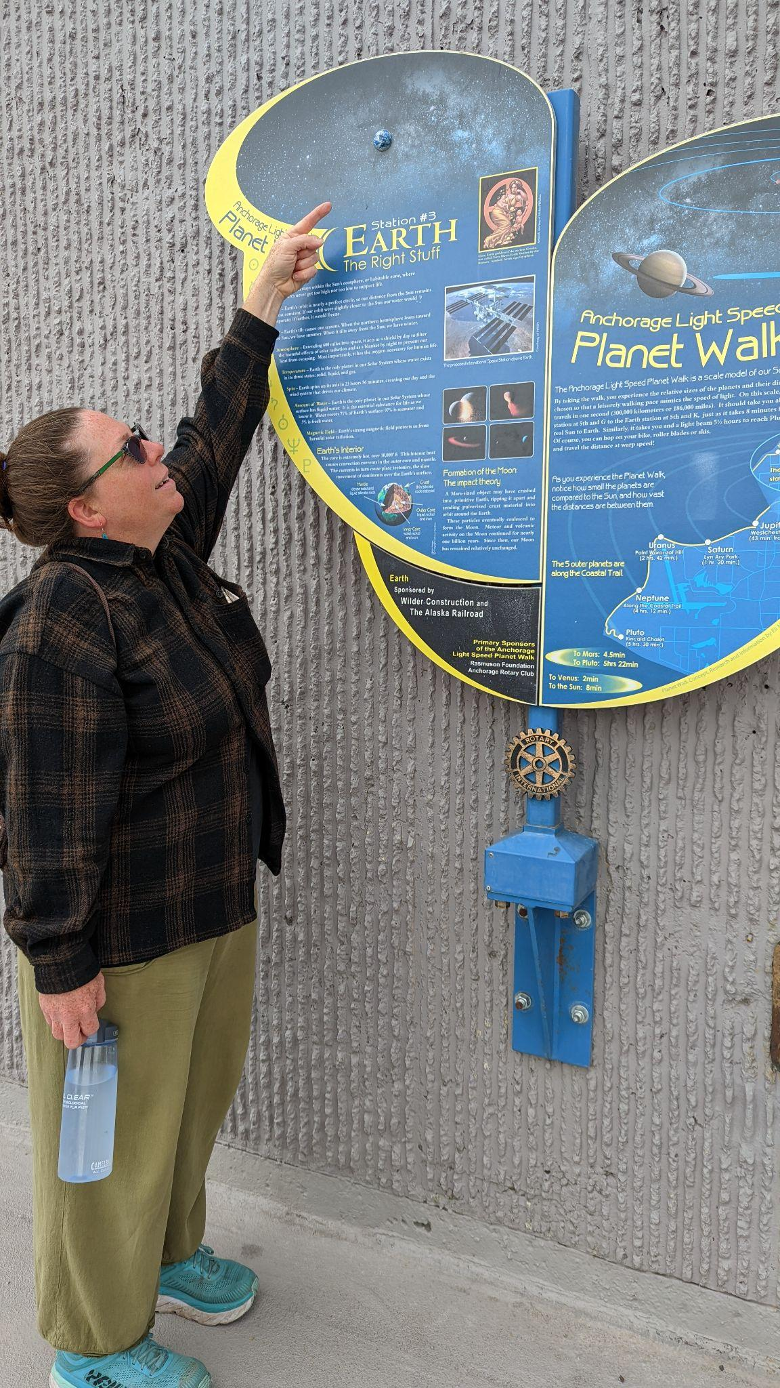
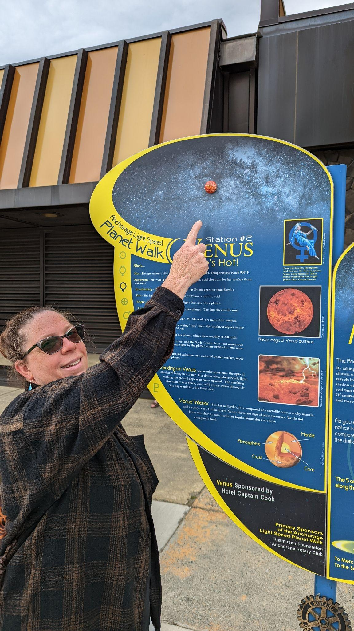
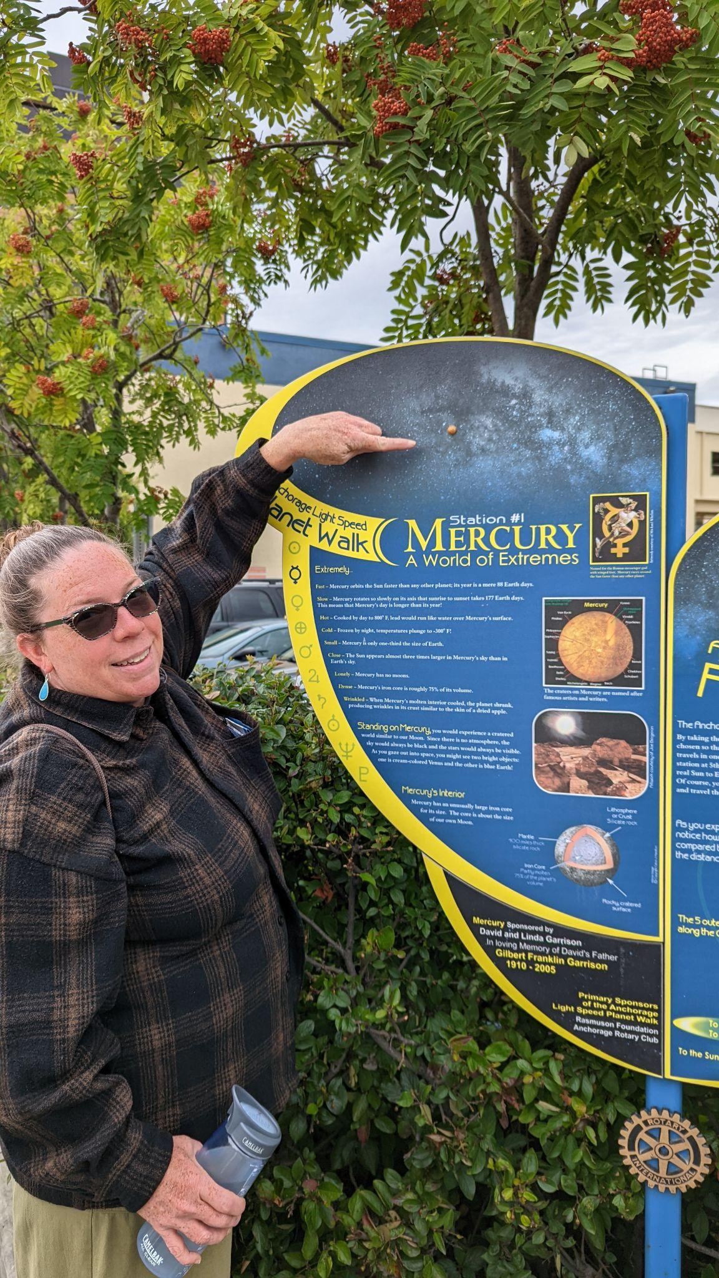
It took 6 minutes to walk here from the sun.
It took 3 minutes to walk here from the sun.
It took 8 minutes to walk here from the sun.
It would take 5.5 hours to reach Pluto.

Slide 27
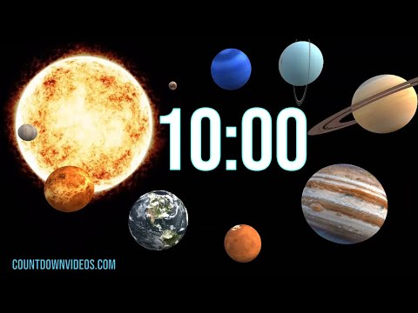
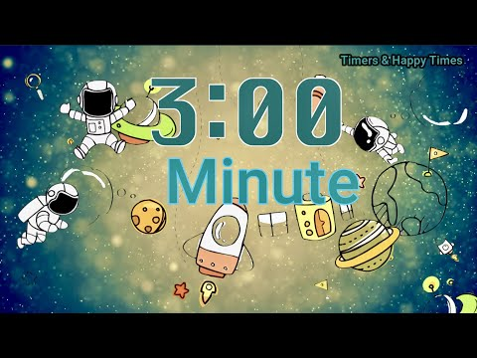
Solar system scale investigation
Day 34
Choose 1 inner planet
Choose 1 outer planet
Research & fill in the table for the project
Project is posted on Google classroom
Sun

Slide 28
Video intro
Why can’t we put the diameter and distance on the same model?
Diameter scale drawing
(15 min)
Distance scale drawing
(15 min)
5 min break

Slide 29
How to make a scale drawing so everything fits on the page
Take your largest diameter value
Divide it by 20 (because the largest circle you can make on a standard size paper is approximately 22 cm and you want things to fit on the page)
This will give you a number that will work as your scale (round it up to the closest whole number)
Put your scale on the page
Now divide both of your diameter numbers by the scale number to find out how big the circle will be
Draw the circles and label them with the name of the celestial body, the actual diameter and the size of the circle you drew
Example: Earth and the Sun
Diameter of the sun = 1392000 km
Diameter of the Earth = 13000 km
1392000 / 20 = 69600
1 cm= 70000 km
Sun diameter to put on the page =19.9 cm
Earth diameter to put on the page = 0.2 cm
Comparing diameter
Comparing distance
Notes:
Make copies for the tables, go over briefly, show on white board

Slide 30
Diameter scale drawing
Find your scale

Slide 31
How to make a scale drawing so everything fits on the page
Take your largest distance value
Divide it by 25 (because the longest straight line you can make on a standard size paper is approximately 27 cm and you want things to fit on the page)
This will give you a number that will work as your scale (round it up to the closest whole number)
Put your scale on the page
Now divide both of your distance from the sun numbers by the scale number to find out how big the circle will be
Draw the dot and label them with the name of the celestial body, the actual distance and the length of the line you drew
Example: Earth and Pluto
Distance of Earth to the sun = 150,000,000 km
Distance of Pluto to the sun = 5,900,000,000km
5,900,000,000/ 25 = 236,000,000
1 cm= 250,000,000 km
Earth’s distance to put on the page = 0.6 cm
Pluto’s distance to put on the page = 23.6 cm
Comparing diameter
Comparing distance
Notes:
Make copies for the tables, go over briefly, show on white board

Slide 32
Distance scale drawing
Find your scale

Slide 33
The intention of using a scale
Is to show how the diameters and distances compare to each other

Slide 34
In order for that to happen you must use the scale you determined for the largest diameter on all the actual diameters
AND
Then use the scale from the farthest distance on all the actual distances
Finish your calculations for your scale diagram/ model
You are trying to show how the diameter and distance compare to each other

Slide 35
Solar system scale investigation
Part 2-
Create your scale model diagrams for BOTH
Distance AND diameter

Slide 36
Video (11:55)

Slide 37
Closer to the Sun, where the temperature was hot, smaller planets formed out of rocks and metals. These inner planets—Mercury, Venus, Earth, and Mars—are known as the terrestrial, or rocky, planets. Mercury and Venus do not have any moons, while Earth has one moon, and Mars has two moons.
Farther away from the Sun, where it was cool, larger planets formed from icy materials, rocks, and gases. The outer planets—Jupiter, Saturn, Uranus, and Neptune—are known as Jovian, or gas giant, planets. While the outer planets might seem like huge spheres of gas, they are not gas all the way through. Deeper in their atmospheres, an increase in pressure and temperature compresses the gas into liquid, and all four of these planets are thought to have solid cores of icy and rocky material. The tremendous gravitational pull of each of these massive planets holds many moons in their orbit.

Slide 38
Beyond the outer planets is the Kuiper Belt, where you will find most of the dwarf planets, including Pluto and Eris. Dwarf planets may have layers of rock, ice, and atmosphere like all the other planets, but they are smaller than the terrestrial planets. Some of these objects also have moons. Leftover materials that were not incorporated into planets or dwarf planets became rocky asteroids, mostly located in the Asteroid Belt between Mars and Jupiter, and icy comets, mostly in the Kuiper Belt and very far away from the Sun in the most distant part of our solar system called the Oort Cloud.
https://contrib.pbslearningmedia.org/WGBH/conv18/npls12_int_toursolsys/index.html
WWTA | Solar System Explorer

Slide 39
Good sources
Solar system planets, order and formation: A guide | Space
Overview | Planets – NASA Solar System Exploration
solar system | Definition, Planets, Diagram, Videos, & Facts | Britannica
https://spaceplace.nasa.gov/menu/solar-system/
https://www.space.com/16080-solar-system-planets.html
https://solarsystem.nasa.gov/planets/overview/
https://www.britannica.com/science/solar-system
https://spaceplace.nasa.gov/menu/solar-system/
Planets For Kids used at table groups for scavenger hunt #2

